Slide 1
IPD Behavioral Results
N=25

Slide 2
Review
C=Cooperate=0
D=Defect=1
SD=‘Sleep Deprived’
SR=‘Sleep Rested’
PRO=Prosocial task partner
ANTI=Antisocial task partner
‘Player’ = Participant
‘Partner’ = Computer
16 trials / run; 2 runs / condition.
ProSocial/AntiSocial Partner random order
Outcome Measures:
Overall Cooperation – rate of cooperation
First Move – Coop or Defect in first interaction?
First Defection – Round of first defection
Conditional Choice
1-back vs 2-back vs 3-back
Choice Deliberation-Time

Slide 3
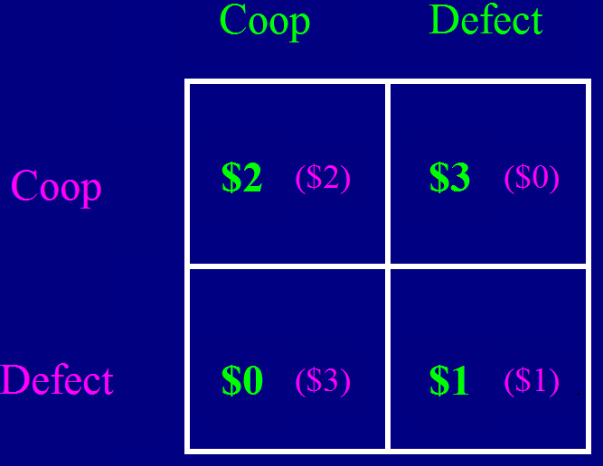
Total Earned: $$
Trial: (x16)
Choice
+
Outcome
+
0sec
6
14
22

Slide 4
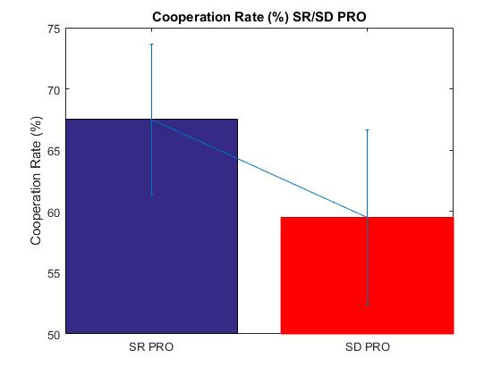
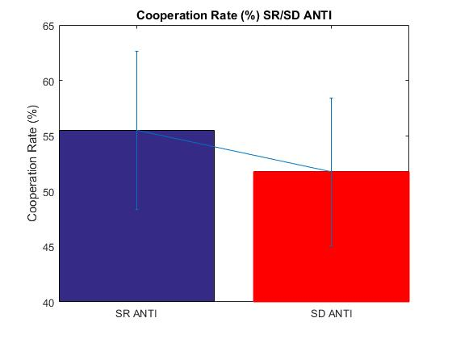
Cooperation Rate
P= 0.5842
P= 0.1232
Excluding participants who only cooperate does not change significance
PRO, p=0.1234; ANTI, p=0.5852

Slide 5
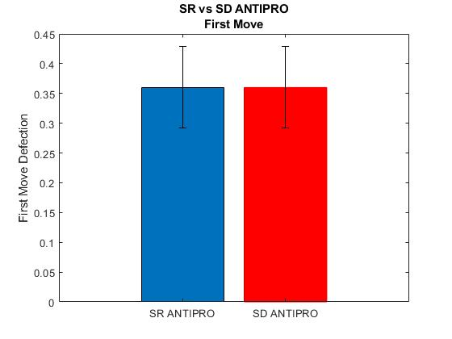
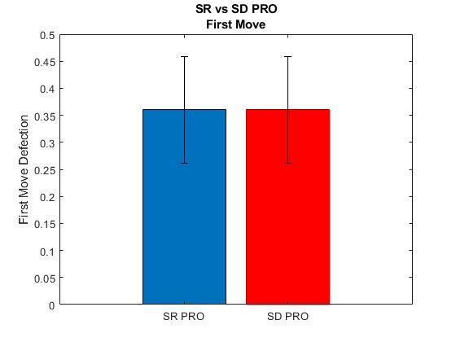

First Round Choice
P=.99
SR and SD identical behavior at beginning of game. Also evident in choice-RTs.
P=.99
P=.99

Slide 6
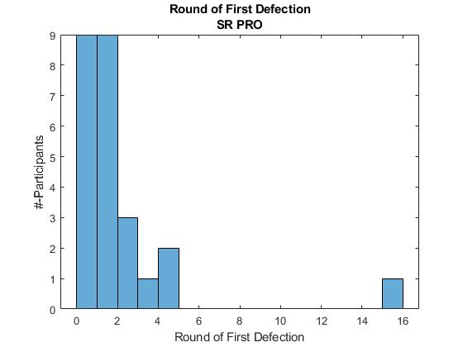
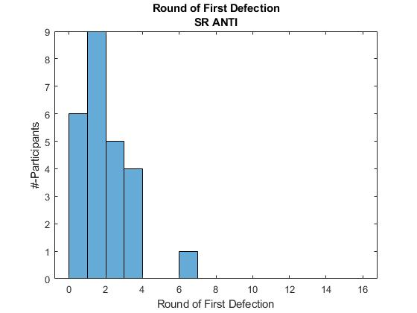
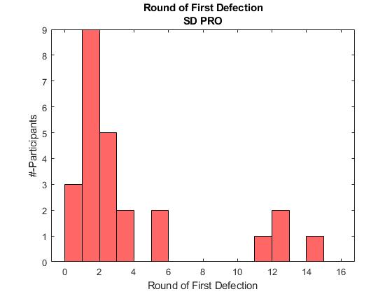
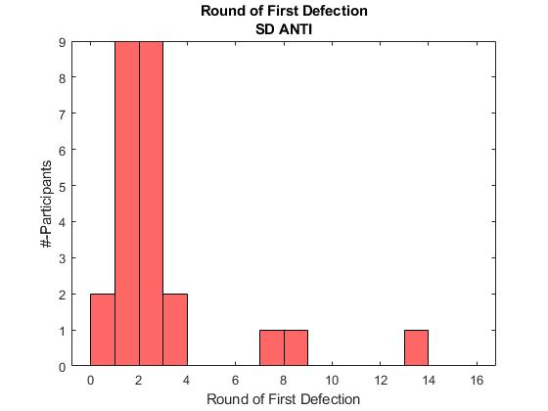
When is first non-cooperative choice? Round of First Defection
*
*
*Always Cooperated
(More constant-cooperators in SR vs SD)
*
*

Slide 7
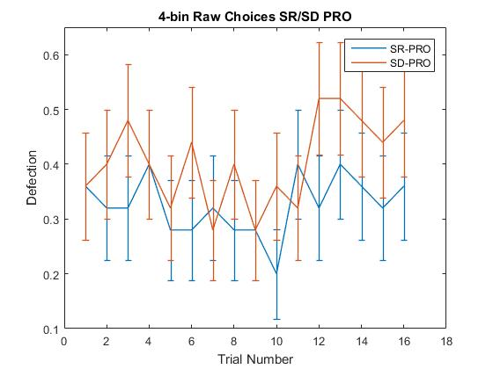
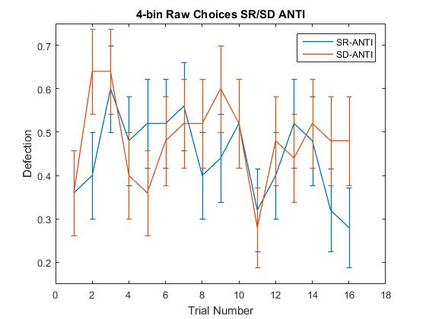
Raw Player Choice Defect=1 Cooperate=0
0.17
0.08
*0.04
0.09
NOTE: Removing participants (n=3, PRO; n=2, ANTI) who purely cooperated does not change these p-values

Slide 8
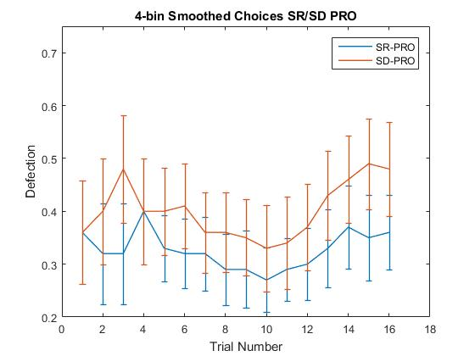
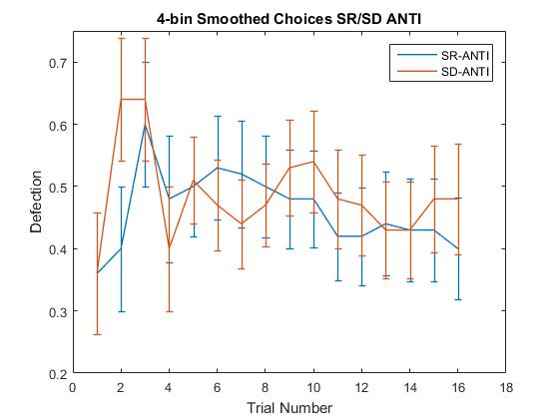
Smoothed Choices Moving Mean (width = 4) Defect=1 Cooperate=0
0.08
*0.04
0.13
0.07
NOTE: Removing participants (n=3, PRO; n=2, ANTI) who purely cooperated does not change these p-values

Slide 9
Conditional Choice Analyses
How is Player Choice affected by prior Partner Choices?
What is the temporal window of previous Partner choices used for subsequent Player choices?
1-back vs 2-back vs 3-back
Is choice deliberation-time affected by prior Partner choice?

Slide 10
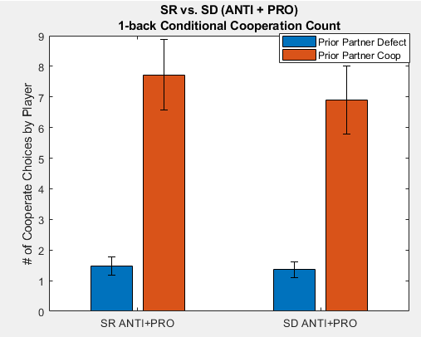
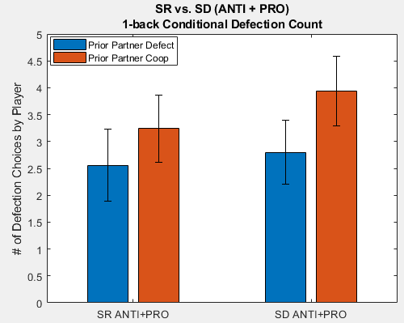
Is Player-Choice affected by prior Partner (1-back) Choice
Player Subsequent-Cooperation
Player Subsequent-Defection
P=0.19
P=0.09
P=0.61
P=0.18

Slide 11
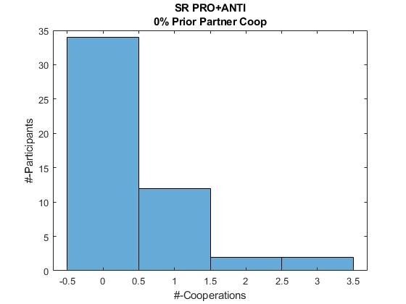
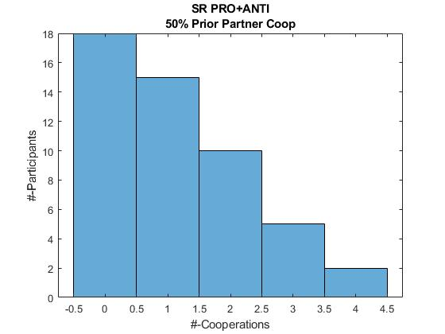
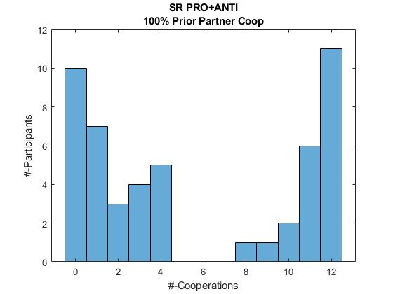
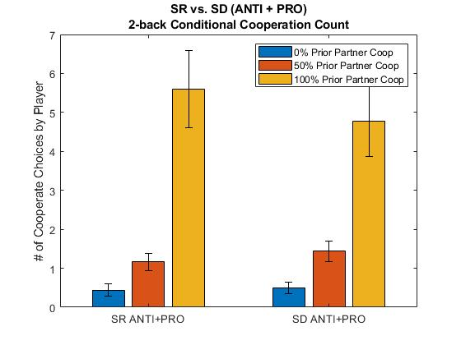
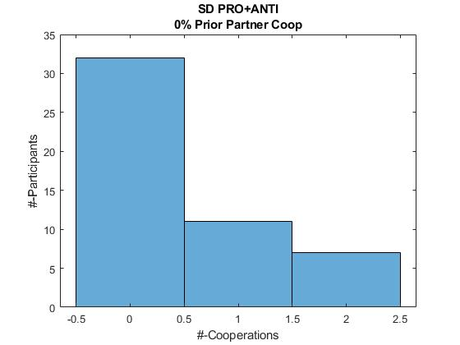
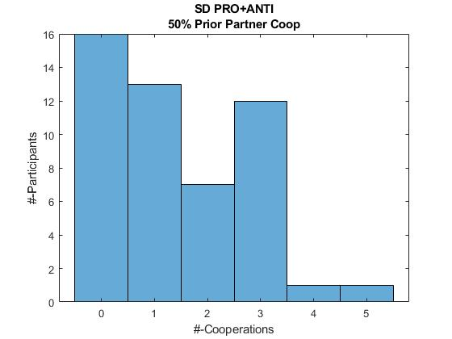
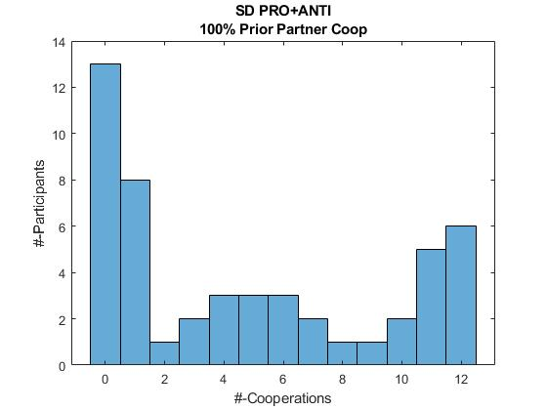
Is Player-Cooperation affected by prior Partner (2-back) Choice
Mean of ANTI and PRO
P=0.089
P=0.21
P=0.61

Slide 12
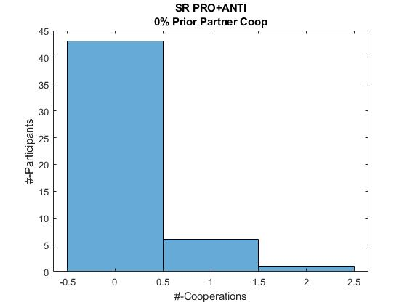
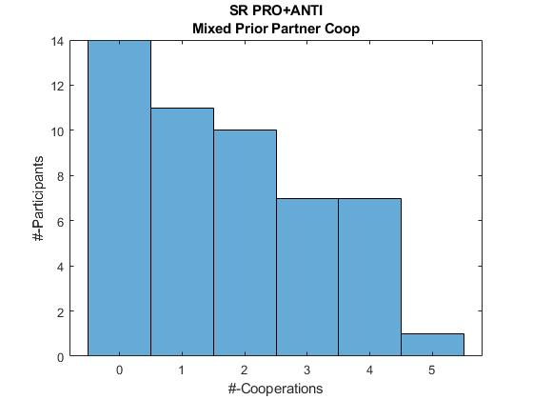
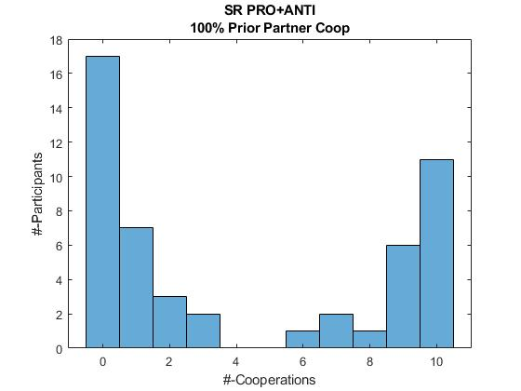
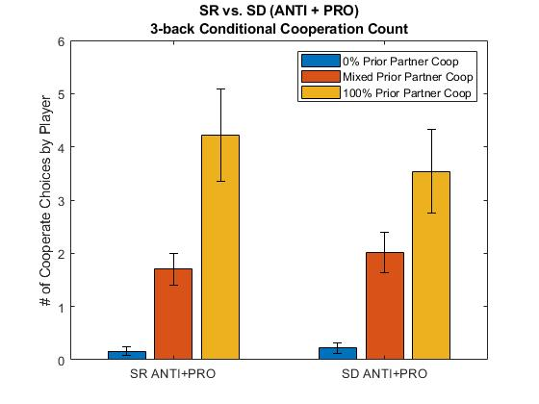
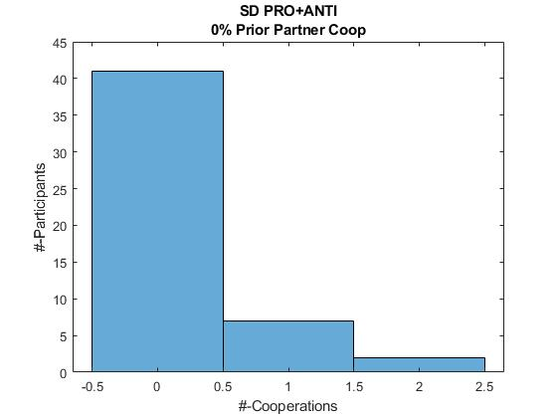
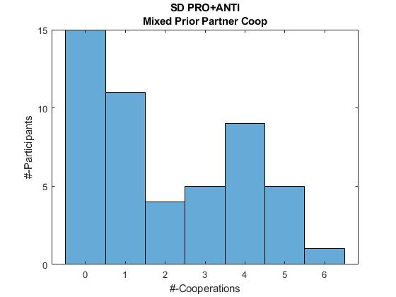
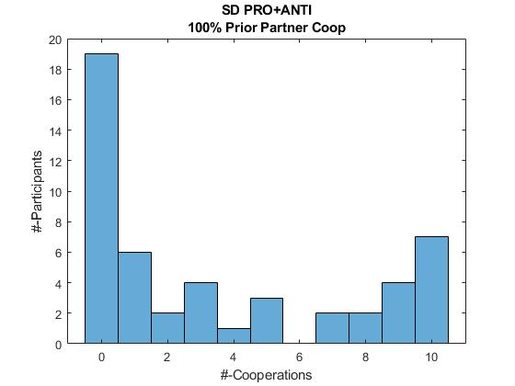
Is Player-Cooperation affected by prior Partner (3-back) Choice
P=0.082
P=0.24
P=0.37

Slide 13
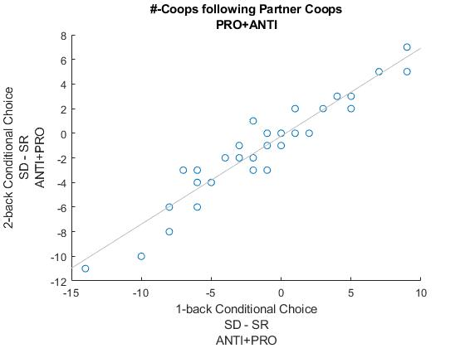
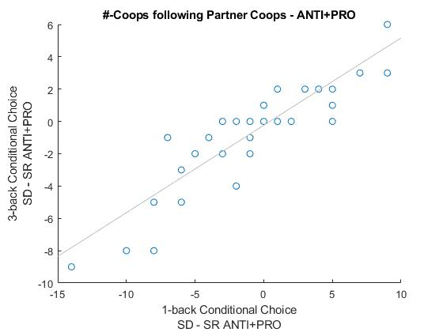
Comparing magnitude of SD-SR
1-back vs. 2-back Conditional Cooperation Count
1-back vs. 3-back Conditional Cooperation Count
R = 0.94
R = 0.87

Slide 14
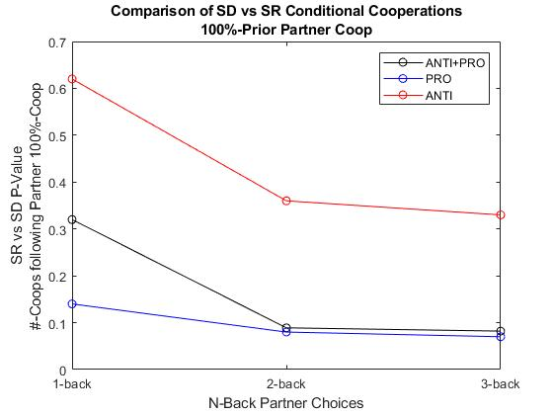
Comparing N-Back Conditional Cooperative Choice Given 100% Prior Partner Cooperation SD vs SR P-values
Maximal SDvsSR conditional cooperation difference using 1-back window, particularly PRO condition.

Slide 15
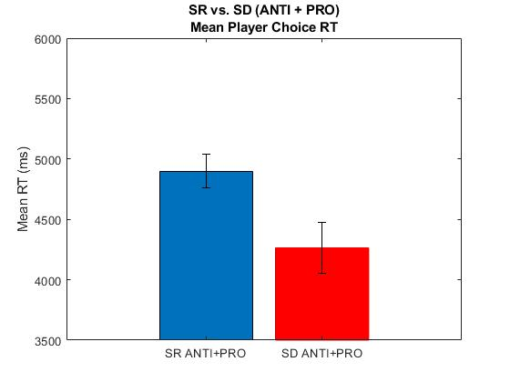
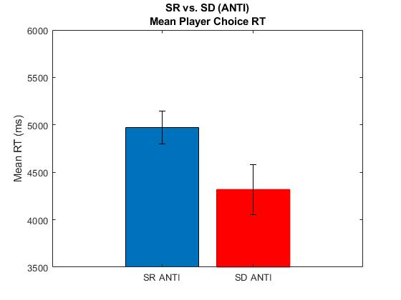
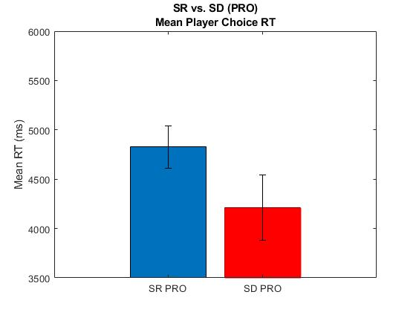
Choice Reaction Time (Deliberation) Analyses
Overall Deliberation time (ms)
SD consistently faster choice
P<0.0001
P<0.0001
P<0.0001

Slide 16
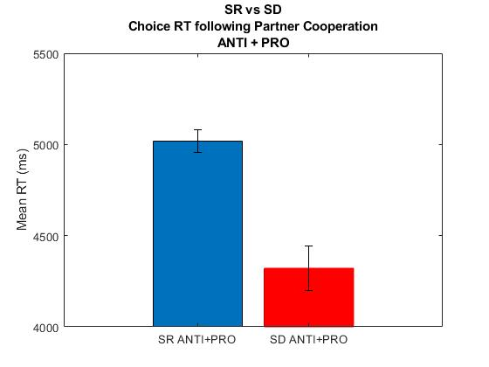
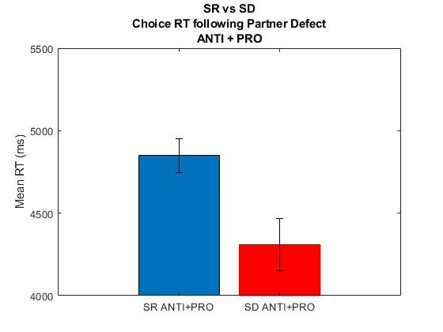
Choice Reaction Time (Deliberation) Analyses
SD consistently faster choice
NOTE: These RTs are averaged regardless of whether Player Cooperated or Defected. See next slide for that.
Deliberation time following partner prior Cooperation(ms)
Deliberation time following partner prior Defection(ms)
P<0.0001
P=0.02

Slide 17
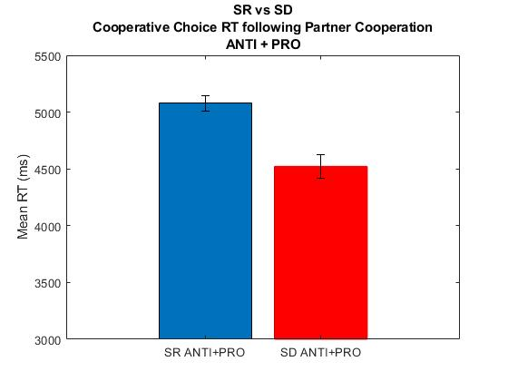
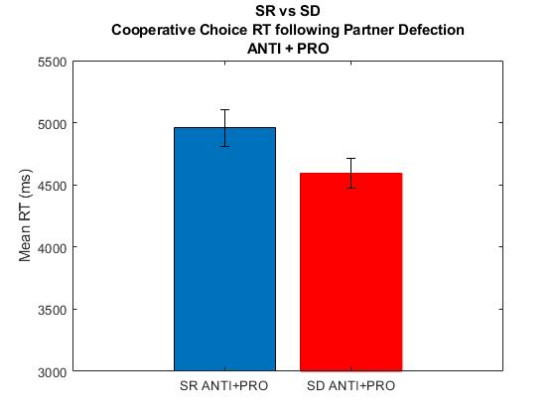
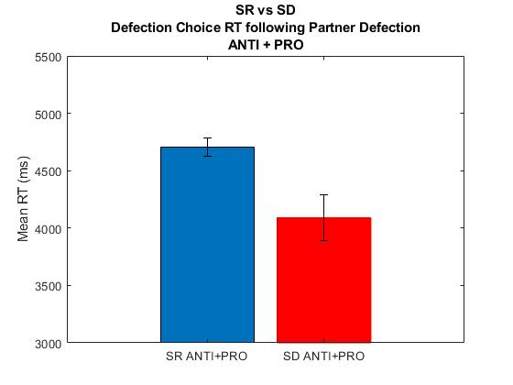
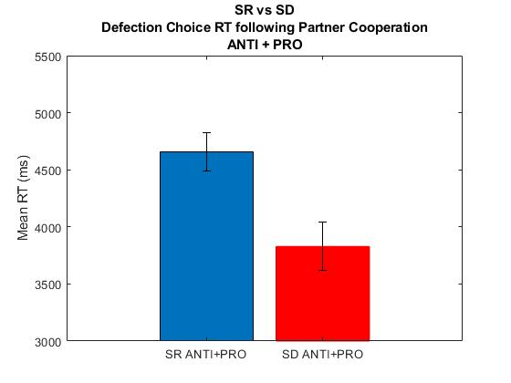
Player Deliberation time (RT) following partner Cooperation or Defection
P<0.00001
P=0.01
P=0.003
P=0.14

Slide 18
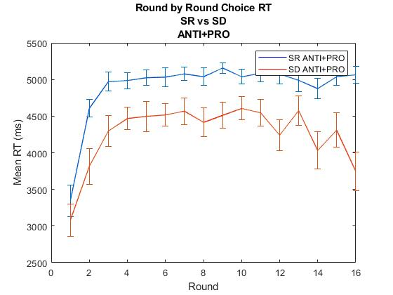
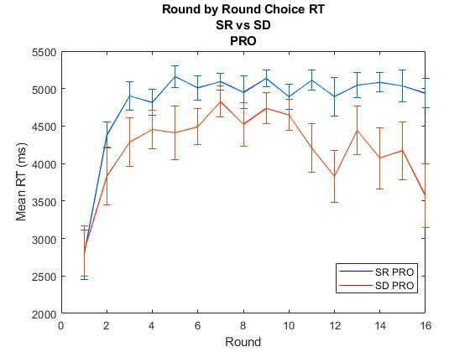
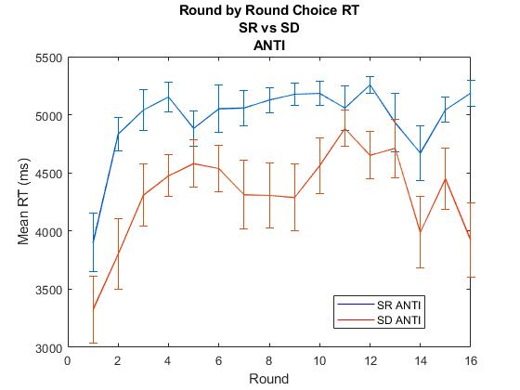
Round by round Choice RT
SR and SD begin at same choice RT, but retain short deliberation time across task, while SR increases deliberation time across task.

Slide 19
Questions / Further Analyses
Overall behavior (e.g. cooperation rate) not significantly different, but reaction times suggest different deliberation strategies following sleep deprivation.
How best to model fMRI correlates of impulsivity (shortened RTs), even though overall cooperation rate not significantly different?
Methods to model social learning. Which data signal learning about partner-type (PRO/ANTI)? Prediction-errors?
How to treat participants who always cooperate, particularly those who always cooperate in both SR/SD conditions?

Slide 20
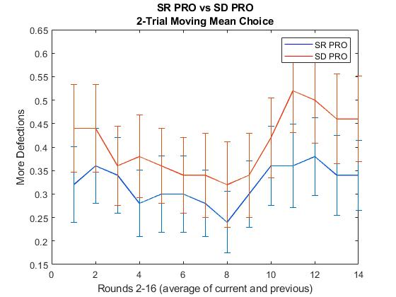
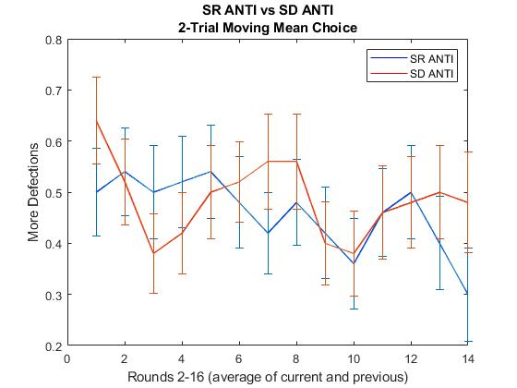
Group Smoothed Choices
2-round moving mean smoothing. Excluding Round 1.
No sig.diff. rounds
No sig.diff. rounds

Slide 21
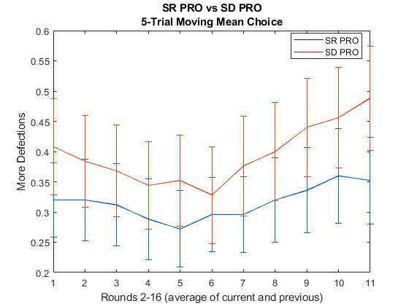
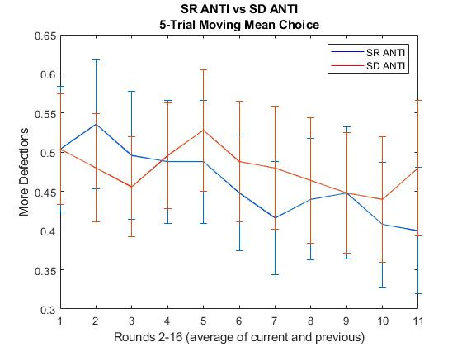
Group Smoothed Choices
5-round moving mean smoothing. Excluding Round 1.
No sig.diff. rounds
No sig.diff. rounds
P=0.06

